Slide 1

Database Management System (DBMS)
(Course code: 21CS2110RA)
CO# 1 ,Session# 7:
Session Topic: Features of Extended ER Model

Slide 2
Session Objective
Students should be able to understand
EER Notations
Design Issues and Concepts

Slide 3
Specialization
  An entity set may include subgroupings of entities that are distinct in some way from other entities in the set.
  For instance, a subset of entities within an entity set may have attributes that are not shared by all the entities in the entity set.
  The E-R model provides a means for representing these distinctive entity groupings

Slide 4
Specialization
Consider an entity set person, with attributes name, street, and city.
A person may be further classified as one of the following:
• customer
• employee
The specialization of person allows us to distinguish among persons according to whether they are employees or customers.

Slide 5
Generalization
The refinement from an initial entity set into successive levels of entity subgroupings represents a top down design process in which distinctions are made explicit.
The design process may also proceed in a bottom-up manner, in which multiple entity sets are synthesized into a higher-level entity set on the basis of common features.
The database designer may have first identified a customer entity set with the attributes name, street, city, and customer-id, and an employee entity set with the attributes name, street, city, employee-id, and salary.

Slide 6
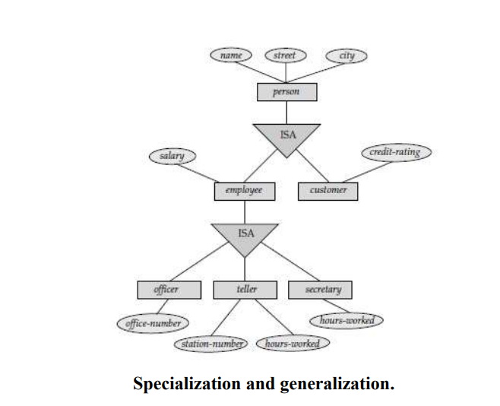
Specialization and generalization

Slide 7
Attribute Inheritance
A crucial property of the higher- and lower-level entities created by specialization and generalization is attribute inheritance.
The attributes of the higher-level entity sets are said to be inherited by the lower level entity sets.
For example, customer and employee inherit the attributes of person.

Slide 8
Attribute Inheritance
Employee is a lower-level entity set of person and a higher-level entity set of the officer, teller, and secretary entity sets.
In a hierarchy, a given entity set may be involved as a lower-level entity set in only one ISA relationship; that is, entity sets in this diagram have only single inheritance.
If an entity set is a lower-level entity set in more than one ISA relationship, then the entity set has multiple inheritance, and the resulting structure is said to be a lattice.

Slide 9
Constraints on Generalizations
The database designer may choose to place certain constraints on a particular generalization.
One type of constraint involves determining which entities can be members of a given lower-level entity set.
Such membership may be one of the following:
Condition-defined
User-defined
Disjoint
Overlapping

Slide 10
Condition-defined
In condition-defined lower-level entity sets, membership is evaluated on the basis of whether or not an entity satisfies an explicit condition or predicate.
For example, assume that the higher level entity set account has the attribute account-type.
All account entities are evaluated on the defining account-type attribute.

Slide 11
Condition-defined
Only those entities that satisfy the condition account-type = “savings account” are allowed to belong to the lower-level entity set person
All entities that satisfy the condition account-type = “checking account” are included in checking account
Since all the lower-level entities are evaluated on the basis of the same attribute (in this case, on account-type), this type of generalization is said to be attributedefined

Slide 12
User-defined
User-defined lower-level entity sets are not constrained by a membership condition; rather, the database user assigns entities to a given entity set
A second type of constraint relates to whether or not entities may belong to more than one lower-level entity set within a single generalization.
The lower-level entity sets may be one of the following:
Disjoint
Overlapping

Slide 13
Disjoint
A disjointness constraint requires that an entity belong to no more than one lower level entity set
In our example, an account entity can satisfy only one condition for the account-type attribute;
an entity can be either a savings account or a checking account, but cannot be both

Slide 14
Overlapping
In overlapping generalizations, the same entity may belong to more than one lower-level entity set within a single generalization
A given employee may therefore appear in more than one of the team entity sets that are lower-level entity sets of employee.
Thus, the generalization is overlapping. As another example, suppose generalization applied to entity sets customer and employee leads to a higher level entity set person.
The generalization is overlapping if an employee can also be a customer.

